Slide 1
RDBMS (RELATIONAL DATABASE MANAGEMENT SYSTEM) AND THEIR FUNCTIONALITIES
Présenter Par :
DRIBRK Chiheb
2021

Slide 2
WHAT IS A RELATIONAL DATABASE MANAGEMENT SYSTEM :
What is a Database?
A database is a set of data stored in a computer. This data is usually structured in a way that makes the data easily accessible.
What is a Relational Database?
A relational database is a type of database. It uses a structure that allows us to identify and access data in relation to another piece of data in the database. Often, data in a relational database is organized into tables.

Slide 3
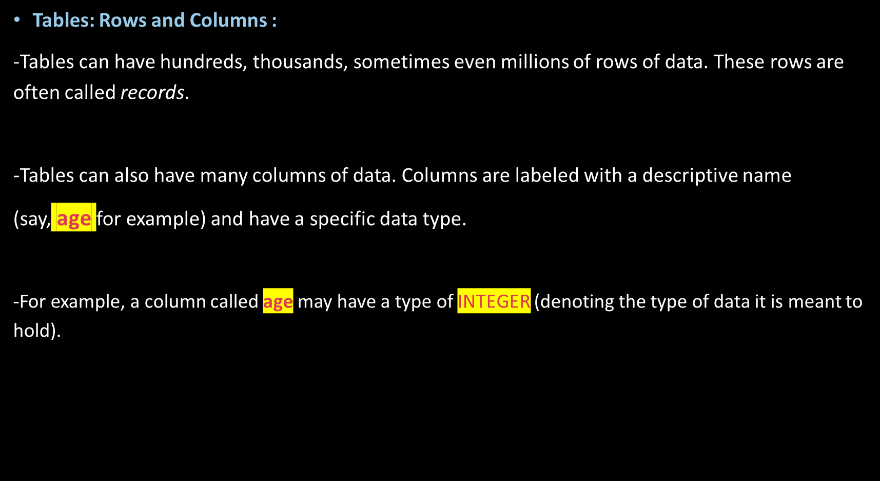

Slide 4
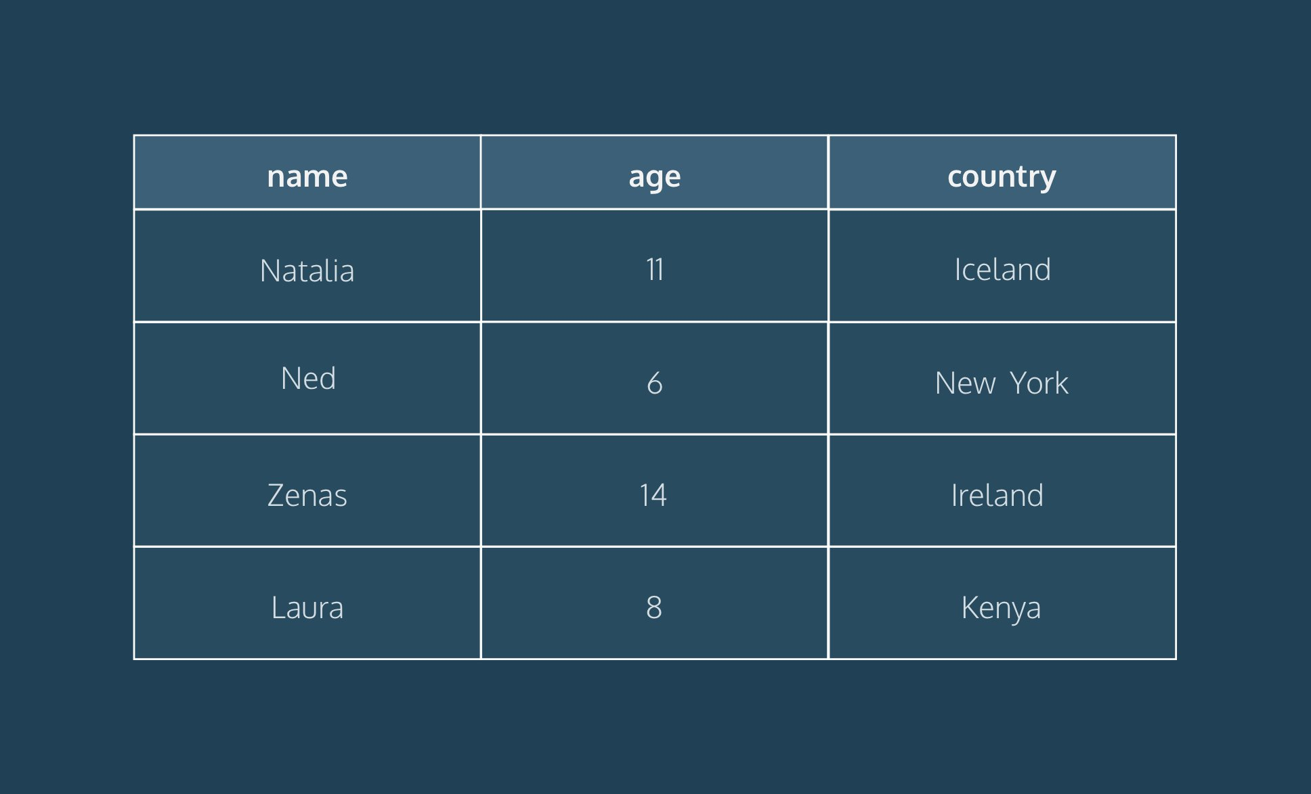

Slide 5
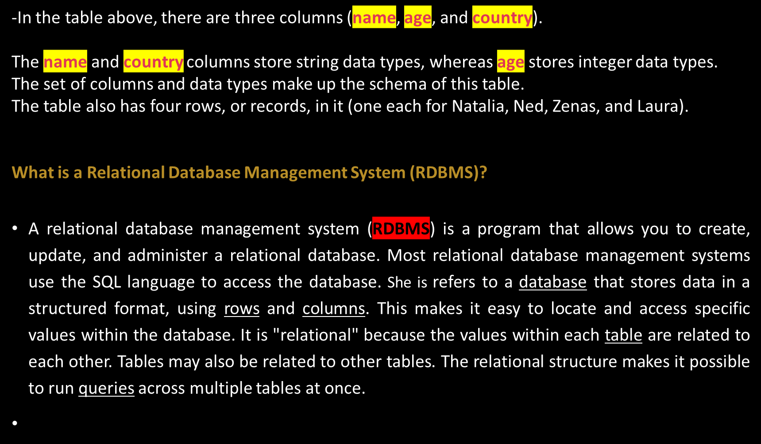

Slide 6
The functionalities of RDBMS :
Number of allowed users: While a DBMS can only accept one user at a time, an RDBMS can operate with multiple users.
Hardware and software requirements: A DBMS needs less software and hardware than an RDBMS.
Amount of data: RDBMS can handle any amount of data, from small to large, while a DBMS can only manage small amounts.
Database structure: In a DBMS, data is kept in a hierarchical form, whereas an RDBMS utilizes a table where the headers are used as column names and the rows contain the corresponding values.

Slide 7
ACID implementation: DBMS do not use the atomicity, consistency, isolation and durability (ACID) model for storing data. On the other hand, RDBMS base the structure of their data on the ACID model to ensure consistency.
Distributed databases: While an RDBMS offers complete support for distributed databases, a DBMS will not provide support.
Types of programs managed: While an RDBMS helps manage the relationships between its incorporated tables of data, a DBMS focuses on maintaining databases that are present within the computer network and system hard disks.
Support of database normalization: An RDBMS can be normalized, but a DBMS cannot.

Slide 8
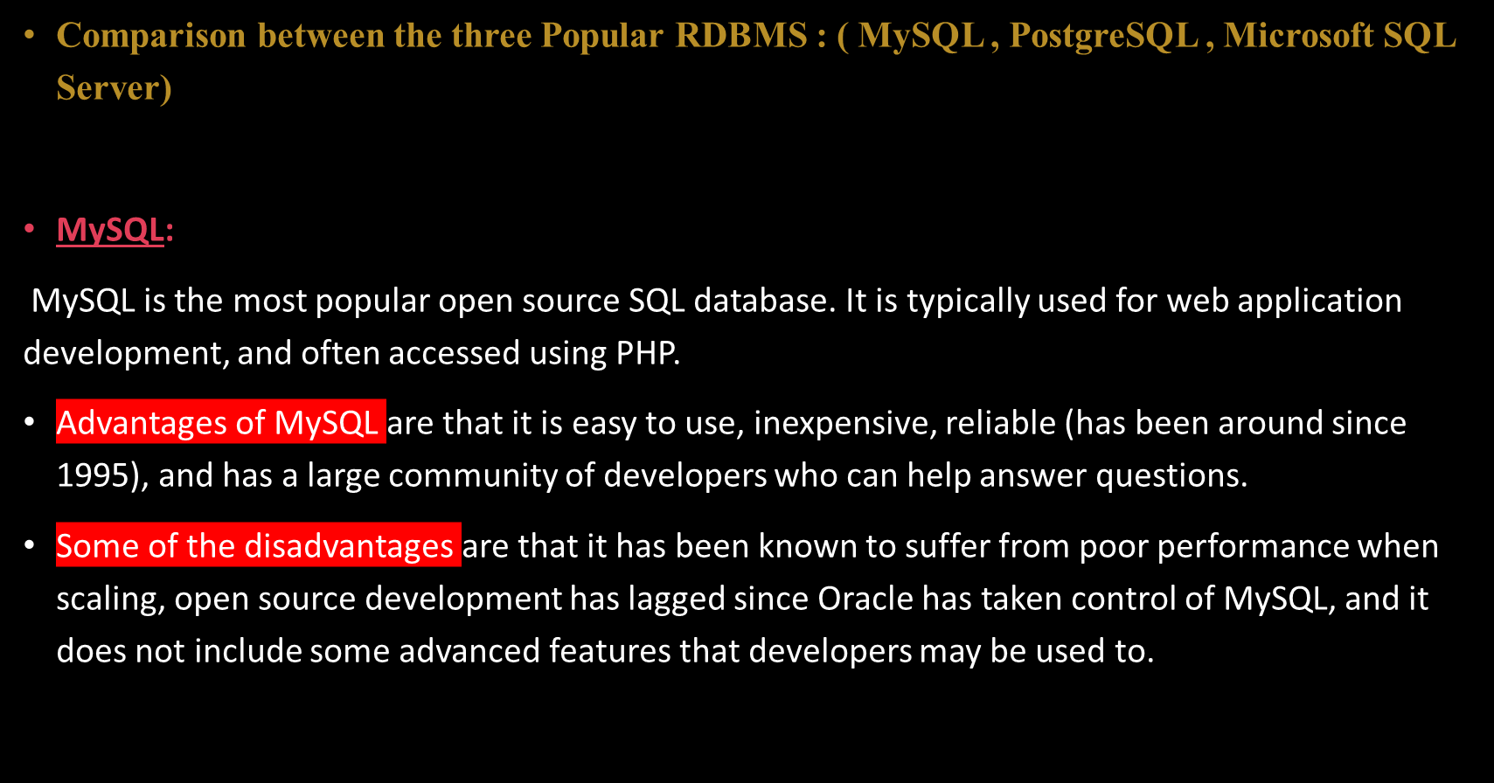

Slide 9
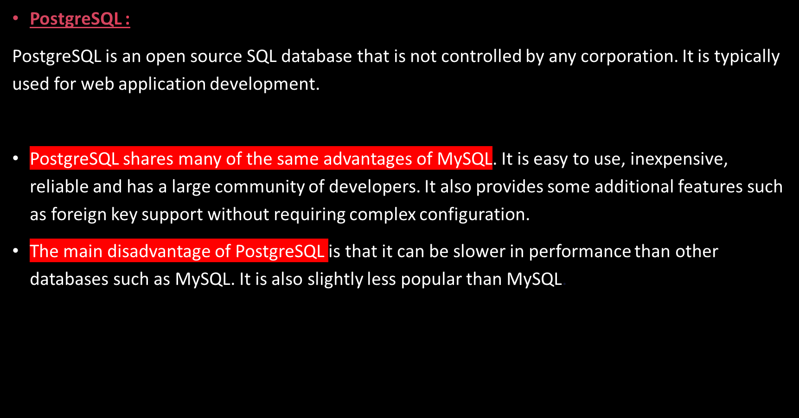

Slide 10
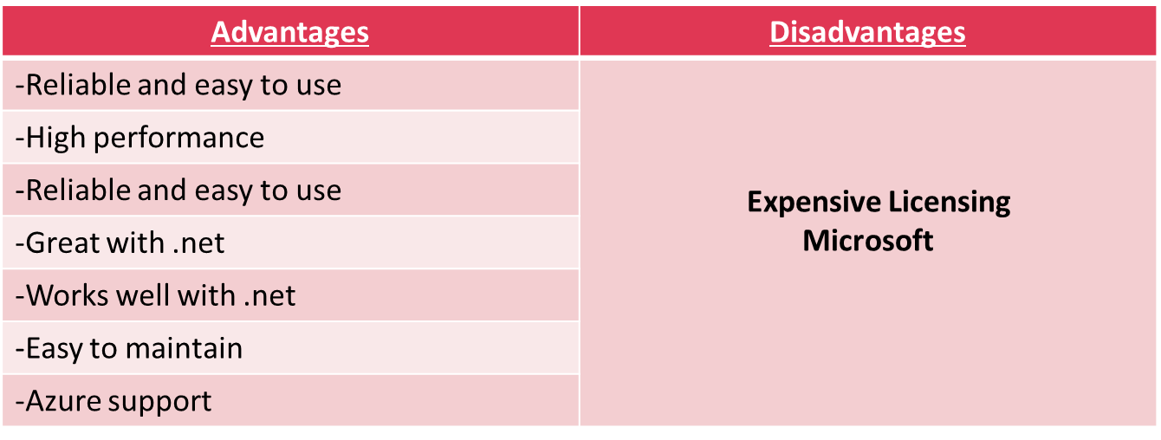
Microsoft SQL Server:
Microsoft owns SQL Server. Like Oracle DB, the code is close sourced.
Large enterprise applications mostly use SQL Server.
Microsoft offers a free entry-level version called Express but can become very expensive as you scale your application.

Slide 11



